Slide 1
The Project and Earned Value
Bruce Link and Eleanor Haupt (ASC/FMCE)

Slide 2
Objectives
Understand theory behind project requirements
Understand basic Earned Value concepts

Slide 3
What We’ll Cover...
Basic EVMS terms
Earned value and the project management cycle
  Planning
  Executing
  Controlling
References (for further reading)
Case Study

Slide 4
Overview of Earned Value

Slide 5
Why use EVMS?
Life without EVMS
Given:
  total budget of $100,000
  12 month effort
  produce 20 units
Status:
  spent to date: $64,000
  time elapsed: 6 months
  units produced: 8 complete, 2 partial
How are you doing, and how do you know how you are doing?
How far along are you? (64%, 50%, >40%)

Slide 6
Why use EVMS?
Early and accurate identification of trends and problems
Accurate picture of contract status
  cost, schedule, and technical
Basis for course correction
Supports mutual goals of contractor and customer
  bring project in on schedule and cost
Notes:
4

Slide 7

What is EVMS?
EVMS is the primary project
management tool...
that integrates the
technical, schedule, and cost
parameters of the contract.
The project manager is the primary tool in the EVMS toolbox.

Slide 8
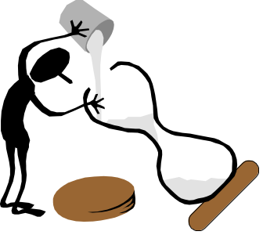
What is the process?
The contractor establishes a management control system
An integrated baseline plan is established
  work is defined, scheduled, and resources are allocated
Work and resources are driven down to lowest level for execution
A work authorization system is set up that controls changes to the baseline
Budgets are “earned” as work is completed = EARNED VALUE
Status provided against baseline
  schedule and cost variances are isolated
Early insight provided into final estimated cost

Slide 9
Basic EVMS Terms

Slide 10
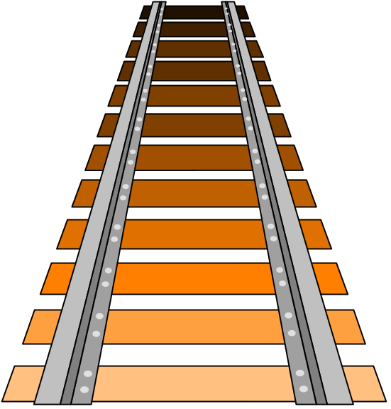
EVMS measures progress
Progress = Movement Forward
to measure progress,
there must be a standard
against which the forward
movement may be compared
EVMS establishes a baseline
to measure progress

Slide 11
What do we measure progress against?
Performance measurement baseline
  budget that is spread over . . .
  time, to accomplish the scope of
  work
  and against which progress can be measured
Earned Value is key concept
  how much progress did I make against my original plan?
  expressed in dollars or hours
baseline
$
earned value
time

Slide 12

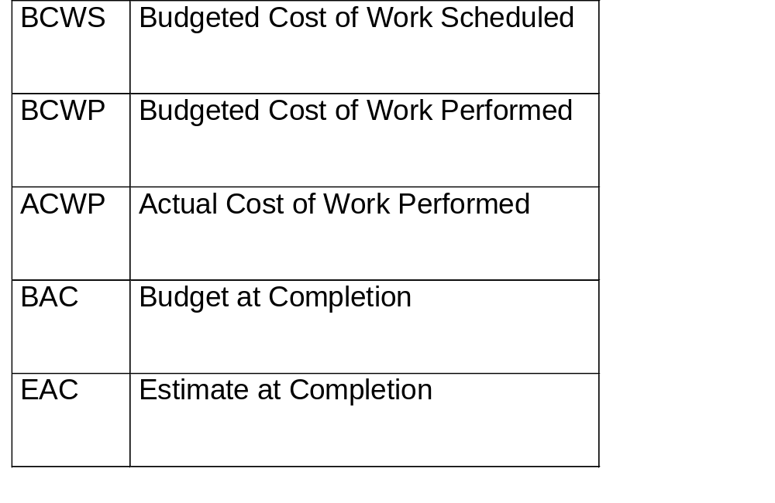




Five Basic Elements

Slide 13

Total Budget
It’s my pleasure to award you this contract for a new railroad
track
hmm...5 miles of track, 5 months to do it all....$5000 budget....This
is going to be tough!
What is the total job supposed to cost?
What is the value of the contract at cost?

Slide 14
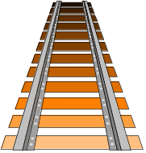

Budgeted Cost of Work Scheduled
(BCWS)
Total Budget = $5,000
to be spent over 5 months
I plan to lay 1 section
of track each month at an
estimated cost of $1,000.
BCWS each month = $1,000
Month 1
BCWS = $1,000
Month 2
BCWS = $1,000
Month 3
BCWS = $1,000
Month 4
BCWS = $1,000
Month 5
BCWS = $1,000
each dollar of BCWS represents a specific dollar of work scope

Slide 15
Budgeted Cost of Work Scheduled
(BCWS)
Total Budget = $5,000
Total BCWS = $5,000
Month 1
BCWS = $1,000
Month 2
BCWS = $1,000
Month 3
BCWS = $1,000
Month 4
BCWS = $1,000
Month 5
BCWS = $1,000
BCWS is aggregated and summed as the performance measurement baseline

Slide 16

Budgeted Cost of Work Performed
(BCWP)
the EARNED VALUE concept
We’re at the end of the
second month, but only
1 section of track is
complete. Value of
work performed = $1,000
You earn value the same way
as it was budgeted in baseline

Slide 17
Schedule Variance
of the work I scheduled to have done,
how much did I budget for it to cost?
BC WS
BC WP
BUDGET BASED
of the work I actually performed,
how much did I budget for it to cost?
SCHEDULE VARIANCE is the difference between work scheduled and work performed (expressed in terms of budget dollars)
formula: SV $ = BCWP - BCWS
example: SV = BCWP - BCWS = $1,000 - $2,000
SV= -$1,000 (negative = behind schedule)

Slide 18
Schedule Variance
5,000
BCWS
“the baseline”
sv
$
BCWP
“earned value”
TIME
5 months

Slide 19
Budget at Completion (BAC)
BAC
$5,000
$
sum of all BCWS =
$
$
$
$
$
$
$
time
when all work has been phased, cumulative BCWS = BAC
e.g., $5,000 = $5,000

Slide 20
At the end...
At the end of the contract, when all work has been completed:
  I’ve “earned” all of my budget ($5,000)
    BCWP (cumulative) = $5,000
    BCWS (cumulative) = $5,000
    therefore, schedule variance ($) = 0
  Formal schedule will reflect whether milestones were achieved on time
Example:
    I finished late, but I did finish
      SV ($) = $ 0
      Formal schedule shows a 5 month actual delay in completing the contract

Slide 21

Actual Cost of Work Performed
(ACWP)
Labor came to $1,300,
and materials cost
$1,100. That first section
of track cost $2,400!
actual expenditures vs. budget

Slide 22
Converting Hours to Dollars
Budgets are managed in dollars, but people think in hours or days
To convert, need pay rates
  how much is one hour by one person worth?
  how much is a project charged for each hour an employee works
Usually companies establish fixed labour rates and assign each employee to one labour rate
  Project uses P1, P2, P3, P4, P5, JS, SS as labels for the labour rates
  For each fiscal year there is a value for each rate
    $ per person-day
    How much project is charged for people in that rate category

Slide 23
Cost Variance
of the work I actually performed,
how much did I budget for it to cost?
BC WP
AC WP
PERFORMANCE BASED
of the work I actually performed,
how much did it actually cost?
COST VARIANCE is the difference between budgeted cost
and actual cost
formula: CV $ = BCWP - ACWP
example: CV = BCWP - ACWP = $1,000 - $2,400
CV= -$1,400 (negative = cost overrun)

Slide 24
Cost Variance
5,000
ACWP
“actual cost”
cv
$
BCWP
“earned value”
TIME
5 months

Slide 25
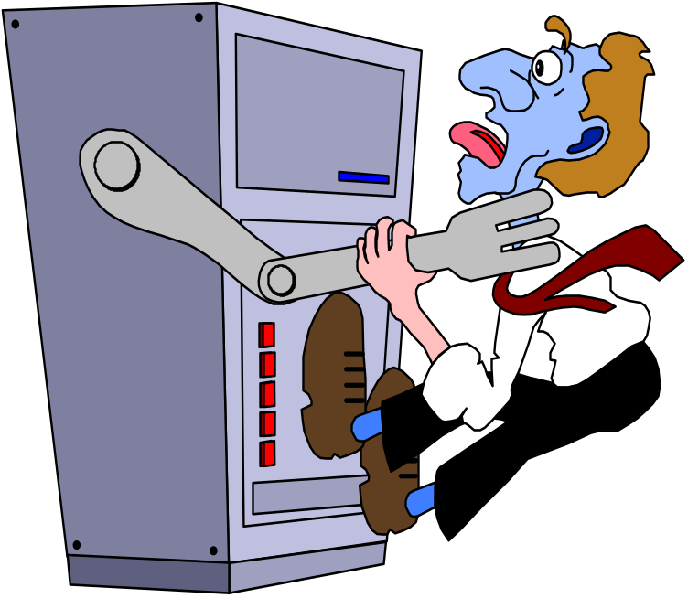
Estimate at Completion
(EAC)
Just a few little glitches…. We should be able to do the complete job….ack…
let’s see, for about $7,500

Slide 26
Variance at Completion (VAC)
B AC what the total job is supposed
to cost
E AC what the total job is expected
to cost
VARIANCE AT COMPLETION is the difference between what the total job is supposed to cost and what the total job is now expected to cost.
FORMULA: VAC = BAC - EAC
Example: VAC = $5,000 - $7,500
VAC = - $2,500 (negative = overrun)
Notes:
We know what our cost and schedule variances are now but we would like to know what our Variance at Completion (VAC) will be.
To determine this we subtract what we expect it to cost (EAC) from what is supposed to cost (BAC) to arrive at a VAC of $1400 or a 28% overrun.

Slide 27
Variance at Completion (VAC)
VAC = Budget at Completion - Estimate at Completion
= BAC - EAC
EAC
VAC
BAC
$
TIME

Slide 28

FIVE BASIC PERFORMANCE DATA
QUESTIONS & ANSWERS
QUESTION ANSWER ACRONYM
How much work should Budgeted Cost for BCWS
be done? Work Scheduled
How much work is done? Budgeted Cost for BCWP
Work Performed
How much did the is done Actual Cost of ACWP
work cost? Work Performed
What was the total job Budget at Completion BAC
supposed to cost?
What do we now expect the Estimate at Completion EAC
total job to cost?
Notes:
We have now answered the five basic performance measurement questions.
How much work should be done? BCWS
How much is done? BCWP
How much did the work actually cost? ACWP
What was the total job supposed to cost? BAC
What do we now expect it to cost? EAC

Slide 29
BCWP Allows Isolation of
Schedule and Cost Variances
5,000
BCWS
ACWP
$
cv
sv
BCWP
TIME
5 months
schedule variance = BCWP - BCWS = negative number
cost variance = BCWP - ACWP = negative number
behind schedule,
over cost

Slide 30
Pop Quiz
BCWS
BCWP
$
ACWP
TIME NOW
schedule variance = BCWP - BCWS =
cost variance = BCWP - ACWP =
_______schedule,
___________cost

Slide 31
Earned Value Management and the Project Management Cycle

Slide 32
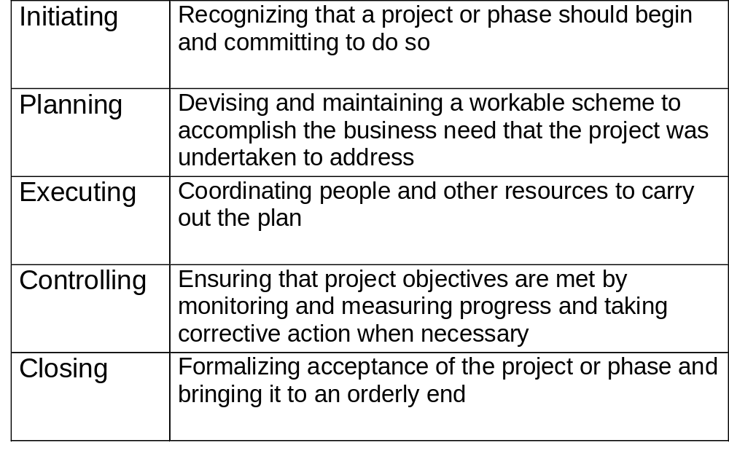
Project Management Processes
Source: A Guide to the Project Management Body of KnowledgeTM,
published by Project Management Institute

Slide 33
How does EVMS fit into Program Management?
program manager needs
Initiate
organize the work and the teams
develop a realistic plan of the work scope, the budget, and the schedule
Plan
Project management cycle
Execute
authorize work properly
Control
control changes
performance reporting
understand variances
corrective actions
forecast of final cost and schedule
Close out

Slide 34

Planning

Slide 35
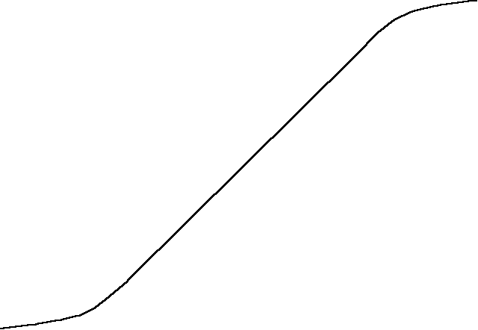
Planning is a 3 Step Process
1. DEFINE THE WORK AND ORGANIZE TEAMS
CONTRACT BUDGET BASE
MR
2. SCHEDULE THE WORK
$
PM BASELINE
3. ALLOCATE BUDGETS
100
40
60
15
25
TIME
30
30
Notes:
5
The baseline is established through a 3-step process.
The first step is to define all the work to be accomplished using
the statement of work and the CWBS.
Then the work is scheduled in time-phased units as shown here.
The last step is to allocate budget to each of these time-phased
tasks.
The result is your performance measurement baseline as shown
without management reserve.

Slide 36

Organizing
Objectives of organizing
  establish a clear picture of the total project work scope
    do we know what all of the work is?
  assign responsibility to the right people

Slide 37
The Organizing Process
Process
  Step 1: define the authorized work using a work breakdown structure (WBS)
    “decompose the work” into manageable chunks
    provides a framework for
      program and technical planning
      cost estimating and resource allocation
      performance measurements and status reporting
  Step 2: define the organizational structure
  Step 3: assign a single chunk of work to a single manager
    control account manager (CAM)

Slide 38
Organizing the Work and Teams
Customer responsibility
  Define upper levels of the WBS (to level 3)
    MIL-HDBK-881, Work Breakdown Structure
    Write initial WBS dictionary and include in request for proposal
  Specify performance reporting levels
Contractor responsibility
  Extend WBS to level where work is performed
    define the elements
    extend WBS dictionary
  Identify organizational structure
    include major subcontractors

Slide 39
Assigning Work
Assignment of a
single work element
to a single team allows
you to roll up the costs
up either direction
WBS
control account
ORGANIZATION

Slide 40
Control Account
Control Account - where the work is done
  Intersection of WBS and organization
Develop Responsibility Assignment Matrix (RAM)
  contractor developed
  Assigns work and resources at lowest level (control account)
  Establishes responsibility for WBS elements
    Control Account Manager (CAM)
    include responsibility for overhead
sum of all control accounts (BAC) = complete statement of work

Slide 41

Integration at the lowest level
Control Account - the key control point
  integrates:
    work scope
      WBS element
      organization
      work authorization
    schedule
    time phased budget (BCWS)
    actual cost accumulation (ACWP)
  earned value determination (BCWP)
  variance analysis (cost and schedule)
    calculation and explanation
  corrective action
  estimate at completion (EAC)

Slide 42
Case Study
Part 1

Slide 43
Contract Award
You are the program manager, I. M. Taz
You just won a contract to eliminate varmints within the state of Arizona
  birds (tweetie and road runner types)
  small animals
You have an organization of highly trained specialists
  L. M. Fudd
  Sil Vester the cat
  Wile E. Coyote
  Daffie Duck (your deputy and the CAM for management)
You have allocated the following budgets from your $50,000 award
  wascally rabbits ($5,000)
  squirrels ($5,000)
  tweetie birds ($20,000)
  road runners ($10,000)
  program management ($10,000)

Slide 44
Organize the work
Build a simple work breakdown structure
Varmint Control
1.1 Small Animals
1.2
Birds
1.3
Program Mgt
1.1.1
wascally wabbits
1.2.1
tweetie
1.1.1
wascally wabbits
1.1.2 squirrels
1.2.2
road runner

Slide 45
Organize the workers
Build a simple organization breakdown structure
I.M. Taz
Program Manager
L. M. Fudd,
small animals
Sil Vester
tweetie birds
Wile E. Coyote
road runners
Daffie Duck
Program Mgt

Slide 46
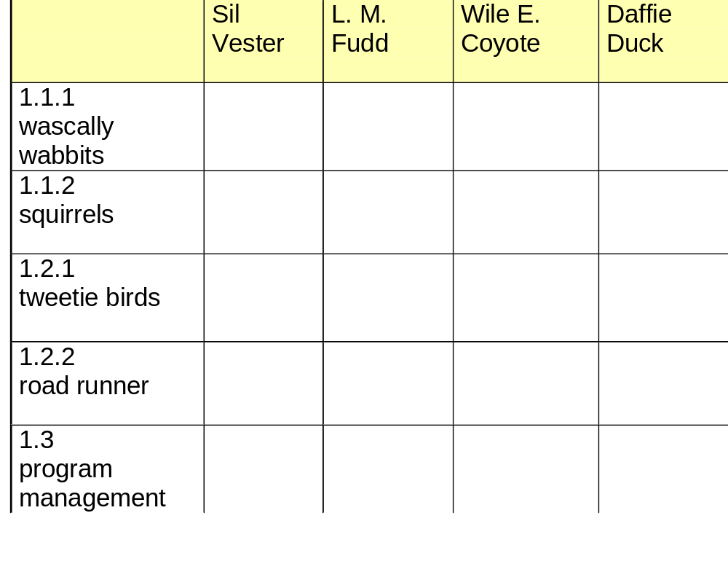
Build a RAM and allocate work

Slide 47
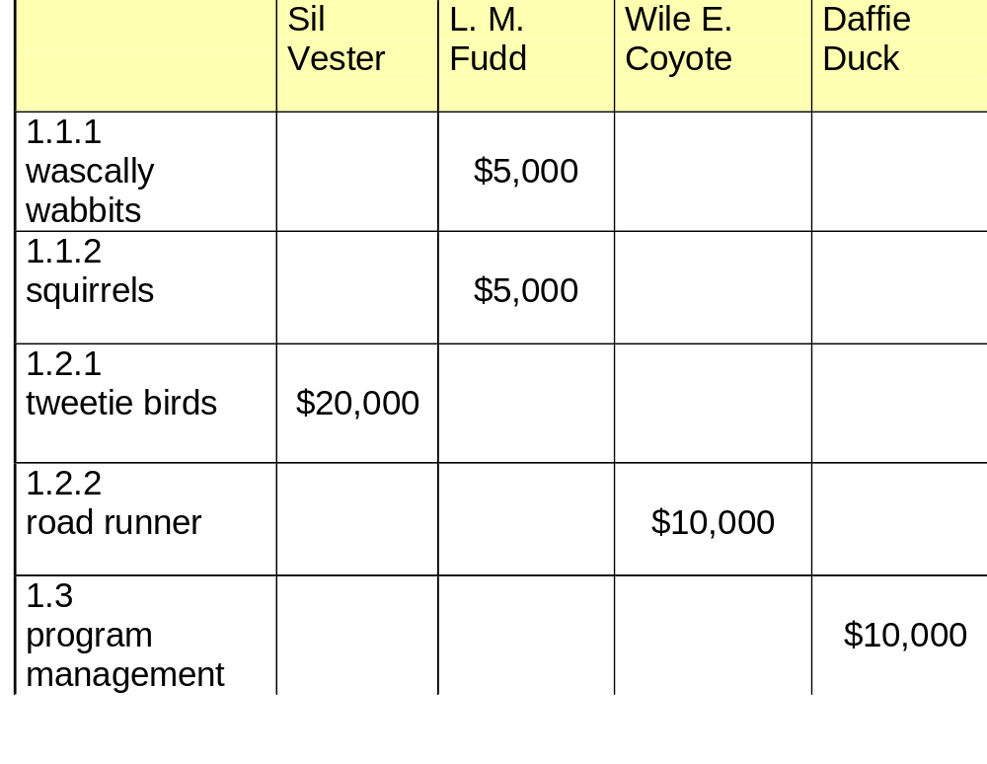
Build a RAM and allocate work

Slide 48


What makes a good control account?
Rules of Thumb for Control Account size
  integrated cost and schedule baseline
    three legged stool
      legs (cost, schedule, technical) are equal
  homogeneity of work
  what is logical to manage every day
  look at:
    character of work
    breakout of labor
    span of control
  typically
    6 - 18 months for discrete effort
    level of effort can be longer
CAM

Slide 49
What’s in a Control Account?
SCHEDULE
TIER 1
TIER 2
BUDGET
Labor 1,000 hrs
Labor $ 75,000
Material $ 25,000
SOW
1.3.4.1
Build ejection seat
CONTROL ACCOUNT PLAN
CAM name: ______ WBS: _______ Total Budget: _________
Work
Work
Work
$
$
$
$
$
$
$
$
$

Slide 50
Work Package
Development of Control Account Plans
  MAY break down the control account budget into smaller work packages
Work Packages
    subset of control account
    reasonably short in duration
    single element of cost (e.g., labor)
    single technique for earning value
    consistent with detail schedules
    has same characteristics as control account
      scope of work
      milestone completion criteria
      single performing organization
      start and end dates
CONTROL ACCOUNT PLAN
Work Pkg #1
Work Pkg #2
Work Pkg #3
$
$
$
$
$
$
$
$
$

Slide 51
Work Package Characteristics
  discrete and measurable
  products or accomplishments
  examples:
    design drawing package
    conduct design review
    install rudder
  rolling wave
    detailed plans made for near term work packages
    planning packages are for future work and are not detailed
    CAMs periodically plan another increment of work packages
  open vs. closed packages

Slide 52
Ways of Earning Value
Earned Value techniques
  Discrete
    physical, tangible end product
  Apportioned
    discrete, dependent on another discrete work package
    example: quality assurance
    planned as historical estimating factor (e.g., 7%)
  Level of Effort
    no tangible end product
    basis of measurement: time
    when clock starts ticking, you automatically accumulate earned value
    no schedule variance
    example: management personnel
Should be a quantitative and discrete way to measure the work
May tie in with success criteria or technical measure
    e.g., successful completion of a specific test, reliability growth curve

Slide 53
Be Discrete!
Discrete EV Techniques:
  Method How Value is Earned
  0/100 no EV at opening, 100% EV at close of WP
  50/50 50% EV at opening, 50% EV at close of WP
  Units Completed same budget value for identical units
  Equivalent Units planned unit standards, allows partial credit
  Weighted Milestone each milestone weighted based on planned resources
  ideal to have a milestone each month
  Percent Complete subjective (least desirable)

Slide 54

Scheduling
Scheduling system characteristics
  complete
    all work included
  formal
    everyone uses same schedule
  traceable
    vertical (Master, Intermediate, Detail)
    horizontal (between tasks)
  consistent
  identifies sequence of tasks, interdependencies

Slide 55
CASE STUDY
Part 2

Slide 56

Contract SOW
SOW Paragraph 1.2.2:
The contractor shall design, build, and install a system
to capture and eliminate the species “Road Runner”
within the state of Arizona.
Contractor’s Winning Design:
The basic system shall consist of five miles of road,
a fake tunnel painted on a side of the mountain,
plus a device to drop an anvil on the Road Runner.

Slide 57
BEEP BEEP INDUSTRIES
CONTROL ACCOUNT AUTHORIZATION
Control Account: Roadrunner
Control Account Manager: Wile E. Coyote
Reason for Issue: Contract to rid Arizona of all unwanted creatures,
F33657-96-C-0221
Scope Description: Perform scope in accordance with Statement of Work. WBS Element 1.2.2
Schedule Requirement: Perform in accordance with Control Account Plan
Budget Authorization: $10,000

Slide 58
Schedule Information
The contract was awarded in Month 1, and will be complete by the end of Month 6.
You can begin building the road immediately, and plan on it taking about one month to complete one mile of road.
It will take approximately three months to develop, build, and quality test the anvil support mechanism (ASM).
You should begin the ASM install during the last month of the build cycle, during quality test. The ASM will take three months to install, and should be the last item completed on the contract, in Month 6.
Based on past experience, you believe that it will take you two months to paint the fake tunnel. You will start it one month before the anvil support mechanism (ASM) begins installation.
The anvil supplier, Acme Anvils, has been a good supplier for you in the past. The anvil is commercial off-the-shelf equipment. You need delivery one month before the install is complete.

Slide 59
Budget Estimate - BAFO
Budget Estimate
1. Procure anvil (sole source - ACME Anvil) $1,500
2. Paint fake tunnel $1,000
3. Build 5 miles of road $3,000
4. Develop and build anvil support mechanism (ASM) $3,000
  design drawings complete & signed off (CDR) (Milestone 1) ($1,000)
  build unit (Milestone 2) ($1,000)
  quality test (Milestone 3) ($1,000)
5. Install system on-site $1,500
Total $10,000

Slide 60
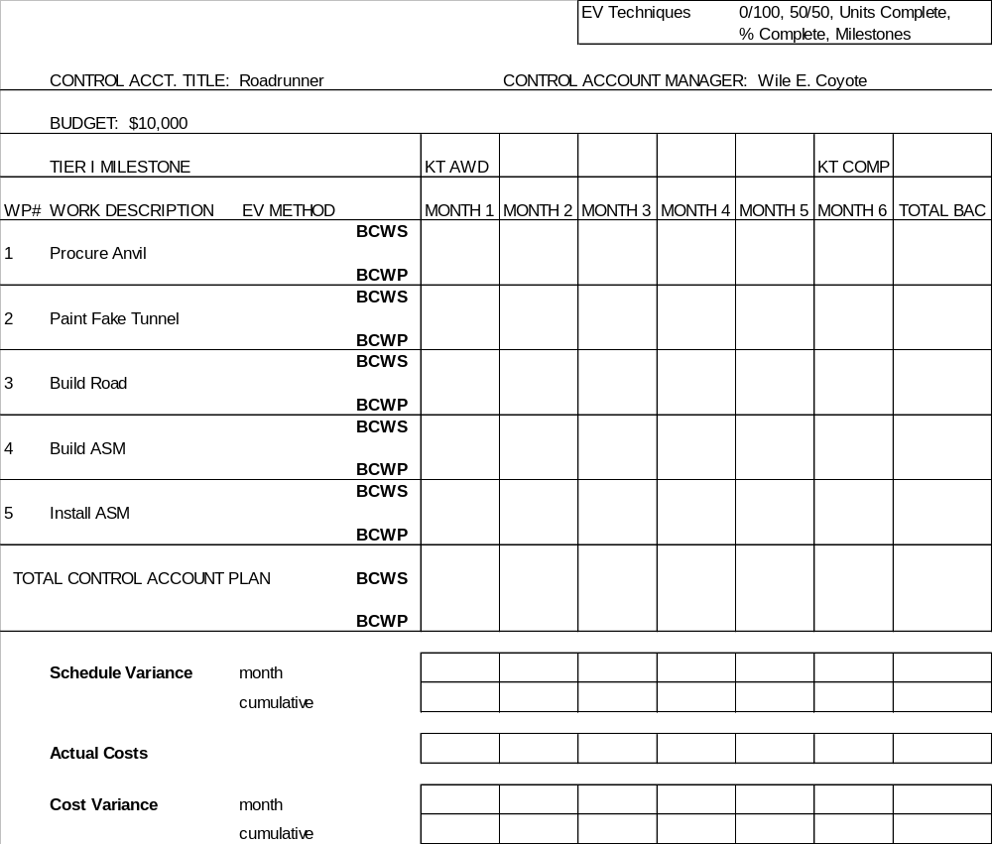

Slide 61
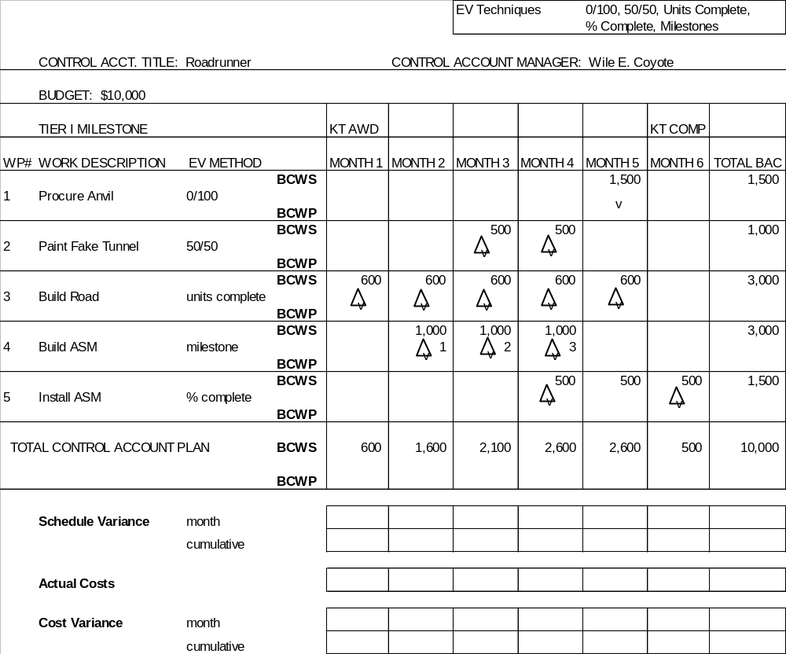

Slide 62

basic rules of the road...
value is earned using the same method as it was planned
sum of the work packages equals the control account budget
sum of the control accounts equals the budget baseline
span of lower tier schedules supports upper schedules

Slide 63

More Acronyms!
Apparently, you’re
starting to understand this!

Slide 64
at the total contract level....
UB Undistributed Budget
= authorized work held at top level until it can be planned in detail
(will eventually have performance measurement)
PMB Performance Measurement Baseline
= time phased budget plan
= detailed planning + UB
MR Management Reserve
= amount withheld at top level for control purposes
(no performance measurement)
= used for unforeseen changes that are within scope of the contract
CBB Contract Budget Base
= PMB + MR
= contract at cost

Slide 65
Rolling Up the Work
CBB
PROFIT
CONTRACT VALUE
MGT RESERVE
$
UB
PERFORMANCE MEASUREMENT BASELINE
$
$
$
$
$
CONTROL ACCOUNTS
$
$
time
TIME NOW

Slide 66

Plans are in place..
The baseline is now in place
  you’ve broken down all the work
  assigned it to teams
  scheduled the work and integrated the schedules,
  and assigned budget resources…..
  schedules and budgets roll up to match the contract
Let’s take the time to evaluate the realism of the baseline
  Integrated Baseline Review (IBR)
  joint contractor/customer team
  within 6 months of contract award or major change
I’d rather be
doing an IBR

Slide 67
Case Study IBR
Historical Data from other Beep Beep programs
1. Average historical cost per mile of road = $750
2. Contractor has no experience in painting tunnels.
3. Contractor has never worked in this part of the country before.
4. Price of raw aluminum on the open market just recently skyrocketed due to heavy demand.
Did we fully plan all work? Do we understand the work?
Do we have a reasonable schedule, with logic indicated?
Do we have enough budget?
Are the earned value techniques valid?
Is the program manager paying attention?
Bottom line: where are the risks to the program?

Slide 68
Execute!

Slide 69

Authorizing the Work
Can only charge to open work packages
  contractor system sets procedure
Contractor maintains baseline log which tracks:
    distribution of budget from Undistributed Budget (UB) to control accounts
    distribution of Management Reserve (MR)
    additions of authorized work
    total equals Contract Budget Base
Contract changes incorporated in disciplined manner
  cannot start work without authorization or budget
Baseline changes are controlled
  Internal replanning
  Over Target Baseline, Over Target Schedule

Slide 70
more rules of the road...
cannot move budget and work independently
cannot use management reserve to cover overruns
may replan open work packages as necessary
  contractor sets internal policy
  maintain valid performance information
cannot change budgets or costs for completed work
  except to fix errors

Slide 71
Case Study
Part 3

Slide 72
EV Update and End of Month Actuals
Month 1: 1 section of road built ($700)
Month 2: Design drawings were completed and signed off ($980)
1 section of road built ($720)
Month 3: The work package for the fake tunnel was opened ($200)
  A labor strike prevented a section of road from being built ($300)
  The ASM began to be built, but the unit was not complete ($800)
Month 4: The tunnel was not completed ($400)
The crew went back on the job, and got paid overtime. 2 road sections built for $1500.
Milestone 2 for the ASM was finally complete. Quality test was pushed out 1 month. ($400)
The install of the ASM was delayed, due to the delay in build.
The anvil was ordered.
Month 5: The anvil was delivered and final cost was $1,700.
The tunnel was complete ( painted). ($500)
The last section of road was built for $700.
Qual test completed. ($1,900)
The CAM estimated that the install was approximately 20% complete ($400)
Month 6: Additional work crews were hired, and the installation was completed.
        The additional crews cost an additional $1,000. ($2,100 total)

Slide 73
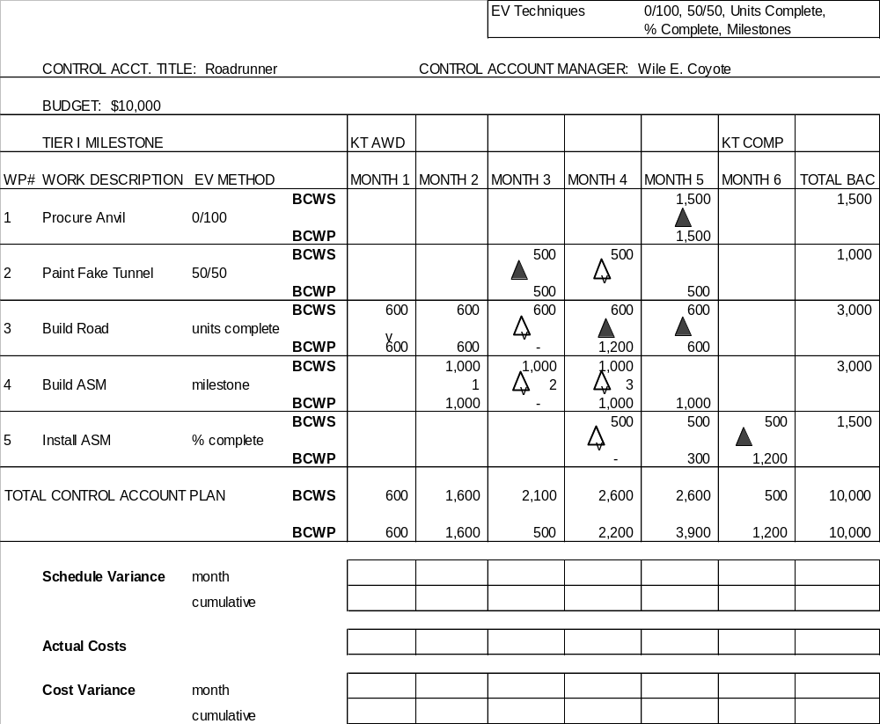

Slide 74
Control

Slide 75


Control
So, your project has been baselined and work has started
Is everything going according to plan?
Next step in the process:
  figure out your status
  figure out the problems
  figure out what you need to do to fix them
  figure out what the impact might be
BCWS
BCWP
$
time

Slide 76
Status Reporting
Assumption: An accurate management control system yields accurate data
Basic principles:
  Report on periodic basic
    weekly
    monthly
  Only ask for the data that you really need and use
    can eliminate certain formats
      WBS versus organizational reporting
    tailor level of reporting to match risk
  Tailor the data to match how you’re managing
    IPTs?
  Make it as real time as possible

Slide 77
Contractor Reports
Cost Performance Report (CPR)
  Format 1: cost and schedule progress by WBS
      (specified reporting level usually at level 3)
  Format 2: cost and schedule progress by organization
  Format 3: changes to performance measurement baseline
  Format 4: manpower forecast
  Format 5: variance analysis
current and cum data

Slide 78
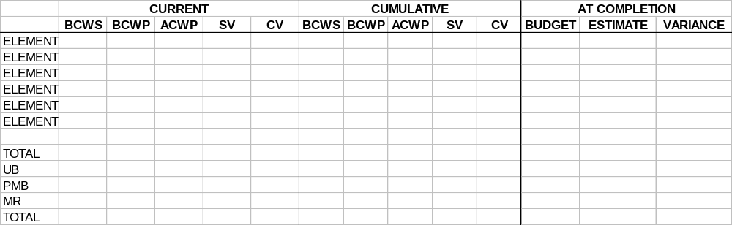
Formats 1 and 2
Contents
  header:
    basic contract information (target, ceiling, name of contractor, etc.)
    range of final estimates
  body
    performance data
    variances
    budget at completion, estimate at completion
WBS or ORGANIZATION

Slide 79
Cost/Schedule Status Report (C/SSR)
Similarities to CPR
  Format 1 (WBS)
  Format 5 (Problem Analysis)
Differences
  Does not require use of approved management system & criteria
  No current period reporting
  BCWS and BCWP may be calculated by logical means at higher levels
Application
  non-major contracts

Slide 80
Analysis Techniques
or
figuring out where the problems are

Slide 81
Analysis Techniques
Sort on significant variances
  eliminate almost complete, just starting, etc.
Graph and analyze trends
Look at comparative data
  e.g. cumulative performance vs. projected performance
Examine written analysis by contractor
  does it answer why?
  adequacy of corrective action plans
Analysis of schedule trends, critical path
Analysis of EAC realism
what are the drivers?
what can we do about them?

Slide 82
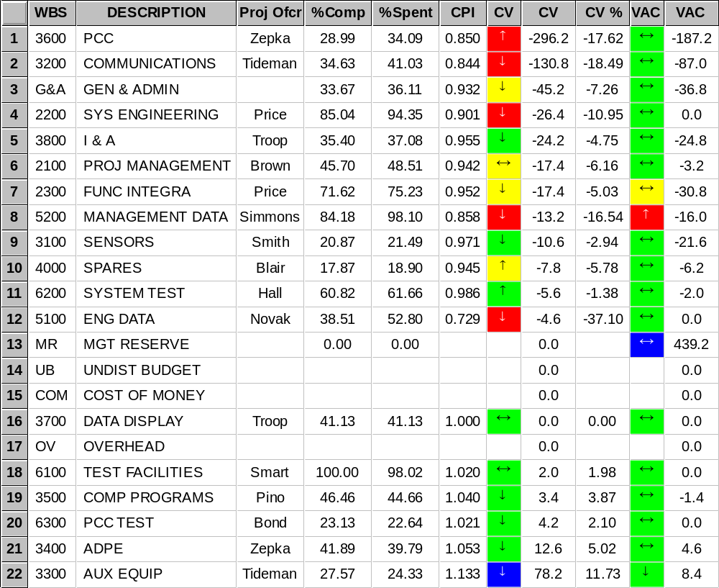
Where are the significant problems?
sorted by CV $

Slide 83
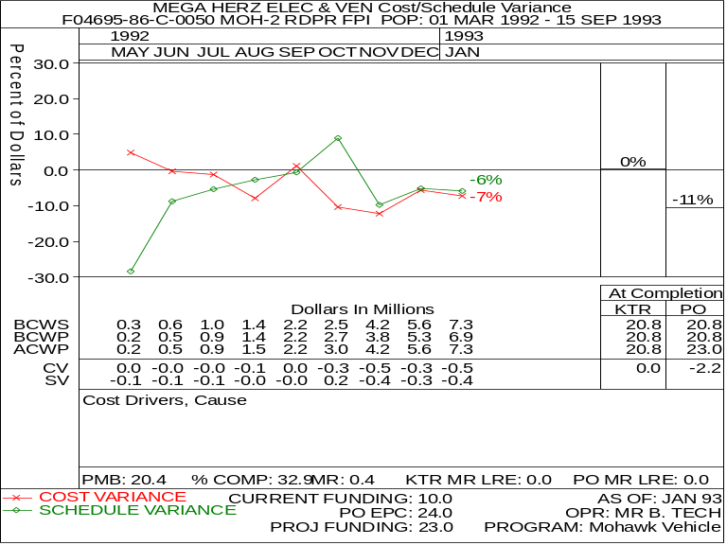
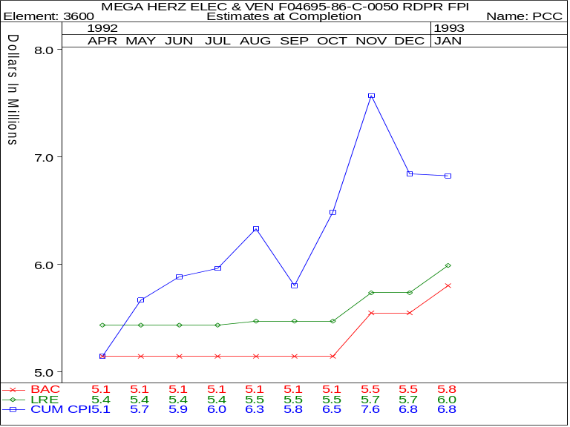

Graphing Techniques
Overall cost and schedule trend
EAC realism
graphs show overall trend...
are you getting better,
or worse?

Slide 84
Analysis of Variances
CURRENT OR CUM TO DATE
Schedule Variance SV ($) = BCWP - BCWS
SV (%) = BCWP - BCWS x 100%
BCWS
Cost Variance CV ($) = BCWP - ACWP
CV (%) = BCWP - ACWP x 100%
BCWP

Slide 85
CASE STUDY
Part 4

Slide 86
Case Study - Accounting Data
Month 1 road $700 700
Month 2 road $720
drawings $980 1,700
Month 3 road $300
tunnel $200 1,300
ASM $800
Month 4 road $1,500
  tunnel $400 2,300
  ASM $400
Month 5 road $700
  tunnel $500
  ASM $1,900 5,200
  anvil $1,700
  install $400
Month 6 install $2,100 2,100
total $13,300

Slide 88
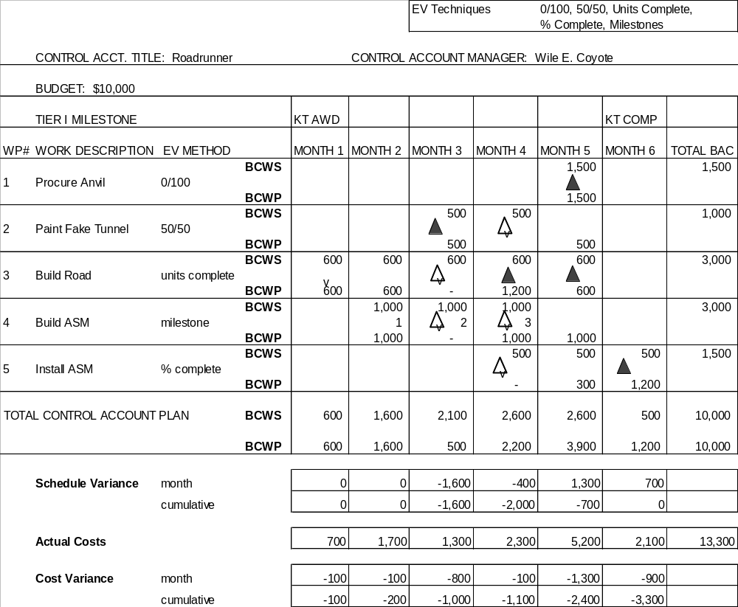

Slide 89
Performance Indices
COST PERF INDEX (CPI) = BCWP
ACWP
SCHED PERF INDEX (SPI) = BCWP
BCWS
1.2
“GOOD”
1.1
TIME
1.0
CPI
.9
“BAD”
SPI
.8

Slide 90
Schedule Status
TIME NOW
% scheduled = BCWS x 100%
BAC
% completed = BCWP x 100%
BAC
Months ahead or behind = SV $
Average monthly BCWS $
BCWS
compare
BCWP
MONTHS BEHIND

Slide 91

Budget Status
budget status
% spent = ACWP x 100%
BAC
compare:
% spent vs. % complete
example: 60% spent vs. 50% complete

Slide 92
Significant Variances
What is a significant variance?
  % variance (e.g., >10%)
  $ variance (e.g., >$50,000)
  critical path element
  risk/complexity
  impact to other elements
  Top 10, Top 20, etc.
  contractor defined

Slide 93
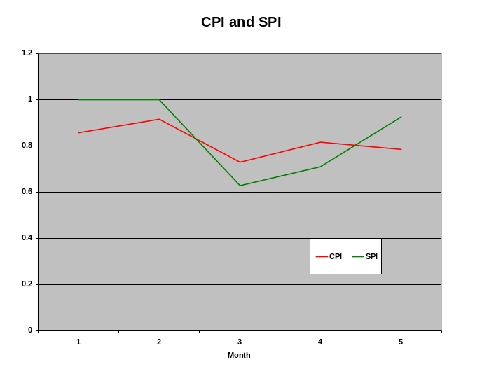
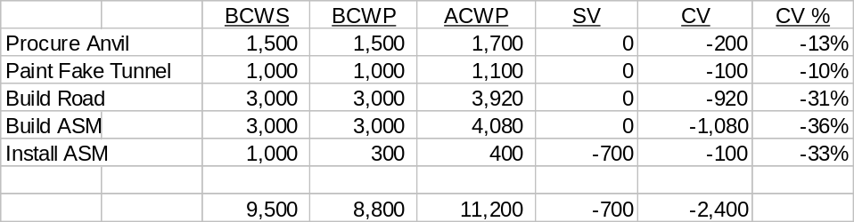
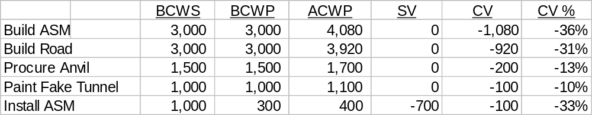
Case Study Analysis
(month 5)
Variance Analysis Report
The program is now 88% complete. We have now spent $1,200 more than our original budget, primarily driven by two problems:
1) building the sections of roads (unforeseen grading problems)
2) manufacturing and quality testing of the ASM (increase in the price of raw stock and higher rates than forecast for quality personnel)
We are only 20% complete on installation, instead of our scheduled 66%. In order to meet contract schedule, we will have to expend overtime. Costs will increase by an expected $1,000.
Performance Report, Month 5

Slide 94

What will be the final cost?
Estimate at Completion (EAC)
  defined as actual cost to date + estimated cost of work remaining
  contractor develops comprehensive EAC at least annually
    reported by WBS in cost performance report
  should examine on monthly basis
  consider the following in EAC generation
    performance to date
    impact of approved corrective action plans
    known/anticipated downstream problems
    best estimate of the cost to complete remaining work
  also called latest revised estimate (LRE), indicated final cost, etc.
        ACWP + ETC = EAC

Slide 95
One method: statistical formulae
Common EAC Formulae:
EAC = BAC
CPI
= ACWPcum + Budgeted Cost of Work Remaining
CPI3
= ACWPcum + Budgeted Cost of Work Remaining
.8(CPI) +.2(SPI)
= ACWPcum + Budgeted Cost of Work Remaining
CPI * SPI

Slide 96
Other methods of EAC calculation
“Grass Roots” or formal EAC
  detailed build-up from the lowest level detail
  hours, rates, bill of material, etc.
Average of statistical formulae
Show range of EACs (optimistic, most probable, pessimistic)
Complete schedule risk analysis for remaining work, estimate work remaining

Slide 97
Why do we need accurate EACs?
Variance at Completion vs. Contractor Loss
  Positive VAC:
    EAC < BAC underrun contractor gain
  Negative VAC:
    EAC > BAC share area contractor partial loss
    EAC > ceiling overrun contractor loss (100%)
Customer develops top level EAC for comparison
  customer will limit progress payments if EAC is greater than ceiling
  customer needs forecast of fund requirements
May still have time to change the final outcome

Slide 98
Additional References

Slide 99
SCHEDULE TYPES
Gantt Chart
- Activities Show a Specific Start and Stop Date
Milestone Chart
- Major Event Oriented. Shows Start or Stop Date of Activity
Line of Balance
- Depicts Production Activity. Actual versus Planned Output
Networking
- Identifies and Defines all Activities and Events for a Program
and Links Them in Logical “Cause and Effect” Sequences
Notes:
There are four basic schedule charts:
The Gantt Chart
The Milestone Chart
Line of Balance Charts and
Networking
I will discuss each of these on the next slide.

Slide 100
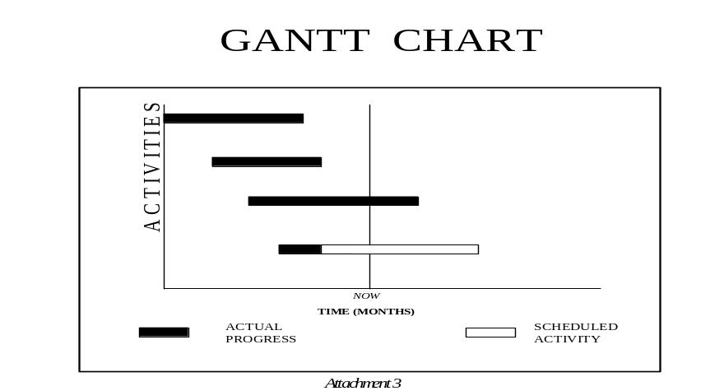
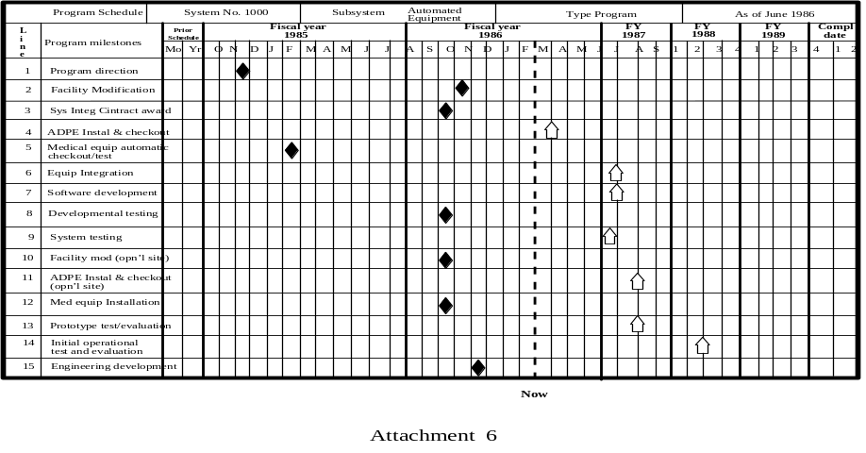
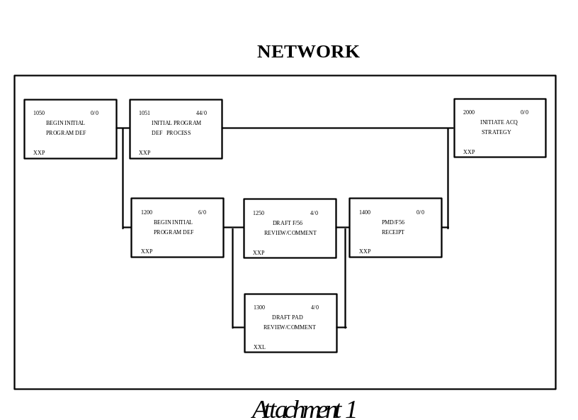
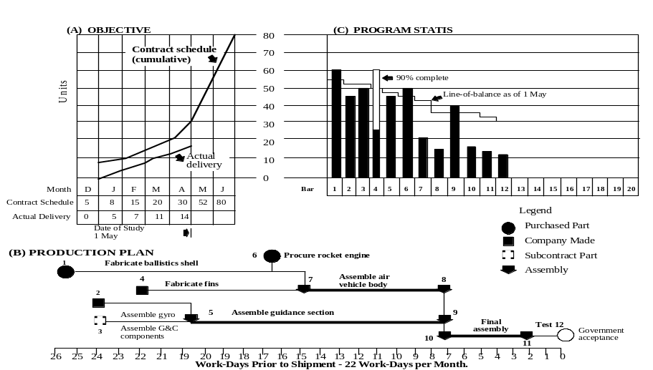
SCHEDULE TYPES (cont’d)
MILESTONE CHART
LINE OF BALANCE TECHNIQUE
Notes:
The Gantt Chart shown here lists program activities with a specified start and stop date.
The Milestone Chart is major event oriented. As you can see it shows a start or stop date for an activity but not amount of time the activity takes.
Line of Balance charts are used primarily for production activity. It depicts actual versus planned output.
The network is the most comprehensive form of scheduling. It identifies all activities and events that must occur on the program and then links them in logical cause and effect sequences. Each activity will show what tasks must occur before it can happen and what tasks it will feed into.

Slide 101
Key Documents in Understanding EVMS
Gary Christle, 22 Jan 94, paper, Implementation of Earned Value - A Model Program Approach
USD(A&T) Letter, 25 Jan 94, Improved Cost and Schedule Performance Management
Gary Christle, 15 Sep 94, paper, The Cost/Schedule Control Systems Criteria and Earned Value Management: A Vision
USD(A&T) Letter, 1 Oct 96, Compliance Responsibility for the Cost/Schedule Control Systems Criteria (C/SCSC)
3 Oct 97, Earned Value Management Implementation Guide (Rev 1)
USD(A&T) Letter, 14 Dec 96, Industry Standard “Guidelines for Earned Value Management Systems”
Wayne Abba, article in Jan-Feb 97 Program Manager magazine, Earned Value Management - Reconciling Government and Commercial Practices
ANSI/EIA 748-1998, Earned Value Management Systems
Quentin W. Fleming & Joel M. Koppelman, book, Earned Value Project Management
Earned Value web page: www.acq.osd.mil/pm

